Slide 1
Energy Efficiency in Residential Sector of Armenia
October 14, 2014
Yerevan, Armenia

Slide 2
ENERGY COSTS IN ARMENIA

Slide 3
ENERGY CONSUMPTION
ELECTRICITY CONSUMPTION
NATURAL GAS CONSUMPTION

Slide 4
ENERGY CONSUMPTION in RESIDENTIAL SECTOR
Annual Energy consumption
Natural gas: 170 m³/capita
Electricity: 1,550 kWh/capita
# of households in multiapartment buildings
An average household with 4 family members is spending over USD $700/year on energy costs

Slide 5
RESIDENTIAL ENERGY EFFICIENCY in ARMENIA
What stops households from doing more EE?
Lack of awareness about technologies and measures expected savings
Lack of financing opportunities
Absence of incentives promoting EE, e.g. tax breaks, rebates, etc.
High cost and shortage of EE materials/equipment
Policy and regulatory field
Overall prioritization of EE by the policy makers
No concrete policy instruments to support implementation of residential EE
Normative filed is being improved by UNDP-GEF Improving EE in Buildings project: catalogue of typical replicable EE houses, package of legislative changes being proposed, energy passports for buildings.

Slide 6
OUR EXPERIENCE
Byblos Bank Armenia CJSC: Advisory services and $10 million loan from IFC
IFC advisory services included:
4 of trainings on Residential EE for the credit and risk specialists of the bank
Transaction support – joint assessment of 10 projects
Provision of HEEL tool
Marketing support – development and publishing of residential EE booklet

Slide 7
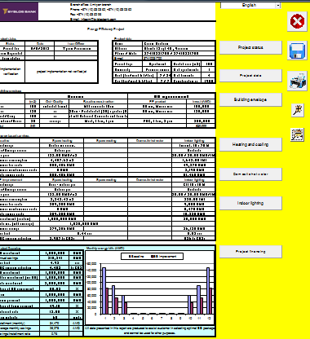
OUR EXPERIENCE
Results:
over 60 projects financed; expected energy saving of over 638 MWh/y; GHG reduction of over 300 tCO2e/y
Typical EE measures in residential sector
Thermal insulation
Efficient doors/windows
Heating and hot water
Lighting and efficient appliances
Using the Renewable Energy Sources

Slide 8
THANK YOU
Tigran Parvanyan Project Manager,
Armenia Sustainable Energy Finance Project
+374 10 545 242
TParvanyan@ifc.org

